Slide 1

PRESENTATION
Housing Price Prediction Project
A case study from US-based housing company looking at prospective properties to buy houses at a price below their actual values and flip them at a higher price which will help the company to enter the real estate market.
Submitted by :-
Sourabh Jhod
Data Science Intern
Flip Robo Technologies

Slide 2
ACKNOWLEDGMENT
I am highly indebted to my Subject Matter Expert MR. Shubham Yadav for their guidance and constant supervision as well as for providing necessary information regarding the project & also for their support in completing the project.
I would like to express my Gratitude to FlipRobo Technologies also who gave me the opportunity to do this project on Housing Price Prediction, which also helped me in doing lots of research wherein I came to know about so many new things also, I have utilized a few external resources that helped me to complete the project. I ensured that I learn from the samples and modify things according to my project requirement.

Slide 3
INTRODUCTION
Surprise Housing is a US based Real estate and housing company who is trying to entry into Australian Real estate market. The company is looking at prospective properties to buy houses to enter the market. We are required to build a model using Machine Learning in order to predict the actual value of the prospective properties and decide whether to invest in them or not.
For this we wants to know:
Which variables are important to predict the sale price of house?
How do these feature variables describe the price of the house?

Slide 4
AGENDA
Analytical Problem Framing
Exploratory Data Analysis (EDA)
Visualizations
Data Pre-Processing on train and test datasets
Model/s Development and Evaluation
Performing hyper parameter tuning, saving the best model and predicting the label
Conclusion and future work discussion

Slide 5
Hardware - Software Requirements and Tools Used
Hardware Used:
RAM: 4 GB
CPU : Intel^{R} Core ™ i3-6006U CPU @ 2.00 GHZ
Gpu: Intel^{R} HD Graphics 520

Slide 6
Hardware - Software Requirements and Tools Used
Software Used:
Programming language: Python
Distribution: Anaconda Navigator
Browser based language shell: Jupyter Notebook
Libraries/Packages Used:
Pandas
NumPy
Matplotlib
Seaborn
Scikit-learn

Slide 7
PROBLEM STATEMENT
Houses are one of the necessary need of each and every person around the globe and therefore housing and real estate market is one of the markets which is one of the major contributors in the world’s economy. It is a very large market and there are various companies working in the domain.
Data science comes as a very important tool to solve problems in the domain to help the companies increase their overall revenue, profits, improving their marketing strategies and focusing on changing trends in house sales and purchases.
Predictive modelling, Market mix modelling, recommendation systems are some of the machine learning techniques used for achieving the business goals for housing companies. Our problem is related to one such housing company.

Slide 8
ANALYTICAL PROBLEM FRAMING
As we are provided with two sets of data, one is for training and other for testing. Here we need to build a machine learning model using train dataset and then by using that model we will make predictions for test dataset.
Both the datasets are in csv format, train dataset has 1168 rows and 81 columns whereas test dataset has 292 rows and 80 columns. Here in the test dataset we do not have the target label and need to predict the same.
And as we have to predict house sale prices in this problem which is a continuous data, I will be using different regression machine learning models.

Slide 9
DATA PREPROCESSING
Importing the libraries.
Loading the training dataset as a dataframe.
Used pandas to set display I ensuring we do not see any truncated information.
Checked the number of rows and columns present in our training dataset.
Checked for Duplicated values present in the data.
Checked for missing data and the number of rows with null values.
Verified the percentage of missing data in each column and decided to discard the one’s that have more than 50% of null values.
Dropped all the unwanted columns and duplicate data present in our dataframe.

Slide 10
DATA PREPROCESSING
Separated categorical column names and numeric column names in separate list variables for ease in visualization.
Performed imputation to fill missing data using mode on both numeric data and for categorical data columns
Replaced Some missing value with a “Missing” category .
Used the visualization libraries (matplotlib , seaborn ) to visualise the data.
checked for outliers and skewness information.
With the help of heatmap, correlation bar graph was able to understand the Feature vs Label relativity and insights on multicollinearity amongst the feature columns.
With the help of Label encoding technique converted all object datatype columns to numeric datatype
Separated feature and label data to ensure feature scaling is performed avoiding any kind of biasness.
Performed the Standard scaling to make data into same scale.
Performed Feature selection using Lasso Regularization to select the important features from all the features.
Finally created a regression model function along with evaluation metrics to pass through various model formats

Slide 11
EXPLORATORY DATA ANALYSIS (EDA) AND VISUALIZATION
1.Univariate Analysis: Univariate analysis is the simplest form of analyzing data. “Uni” means “one”, so in other words your data has only one variable.
2. Multivariate Analysis: Multivariate analysis is a set of statistical techniques used for analysis of data that contain more than one variable.
3. Correlation of Dataset: Correlation is used to test relationships between quantitative variables or categorical variables.
4. Correlation with Target variable: Correlation with the target variable to know how the data is related.
5. Conclusion: Summary with the conclusion of all the analysis

Slide 12
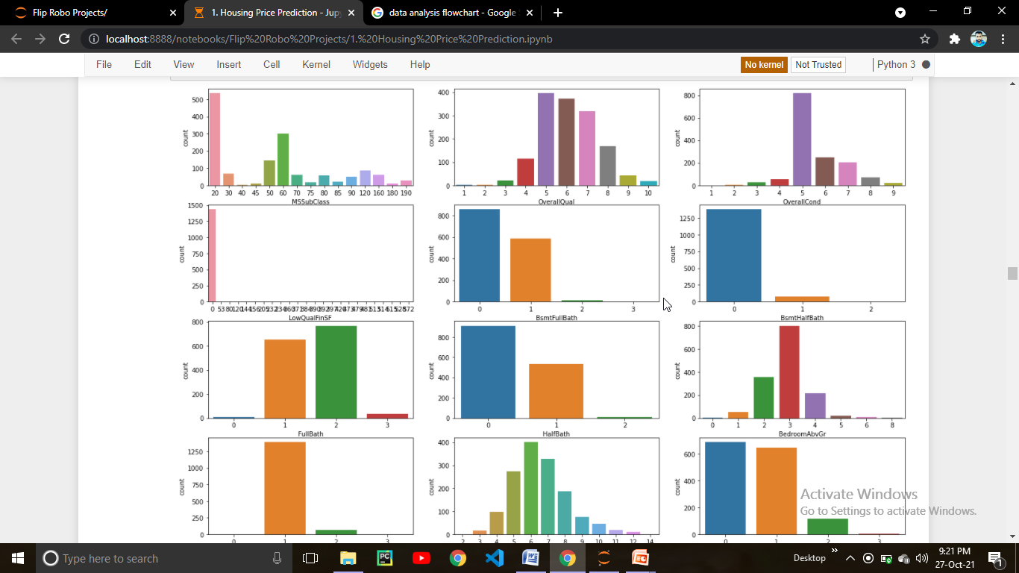
COUNT PLOT
Count plot method is used to show the counts of observations in each categorical bin using bars.
Parameters : This method is accepting the following parameters that are described below: x, y
This parameter take names of variables in data or vector data, optional inputs for plotting long-form data.

Slide 13
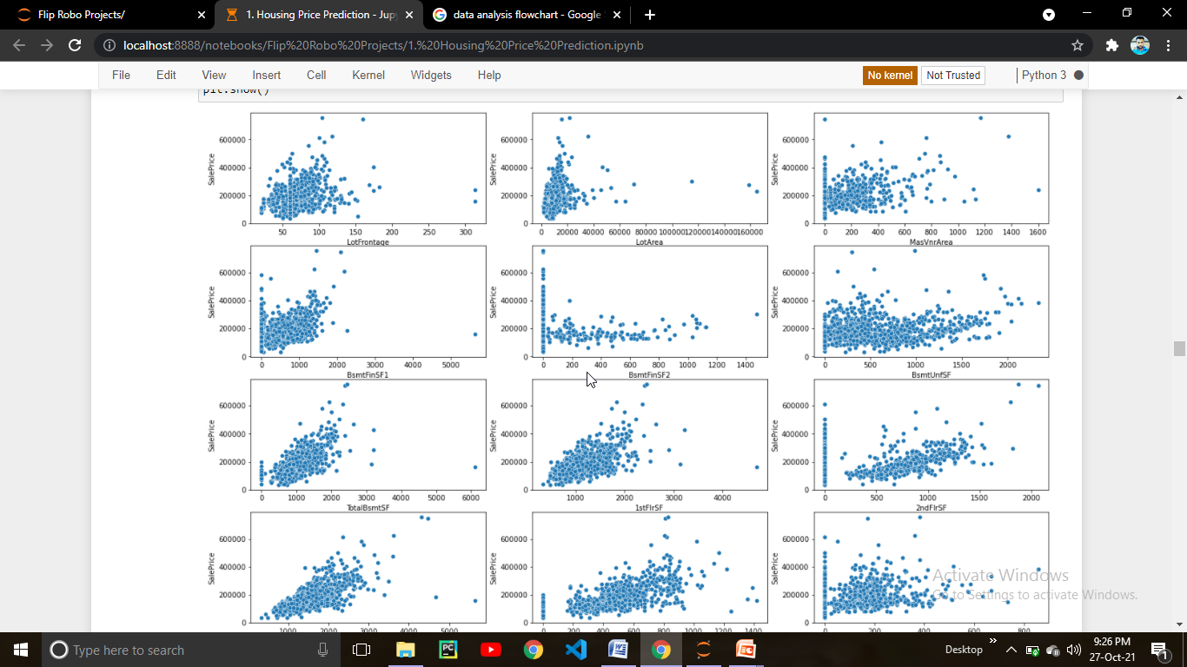
SCATTER PLOT
Scatter plots are used to observe relationship between variables and uses dots to represent the relationship between them.
The scatter method in the matplotlib library is used to draw a scatter plot.
Scatter plots are widely used to represent relation among variables and how change in one affects the other.

Slide 14
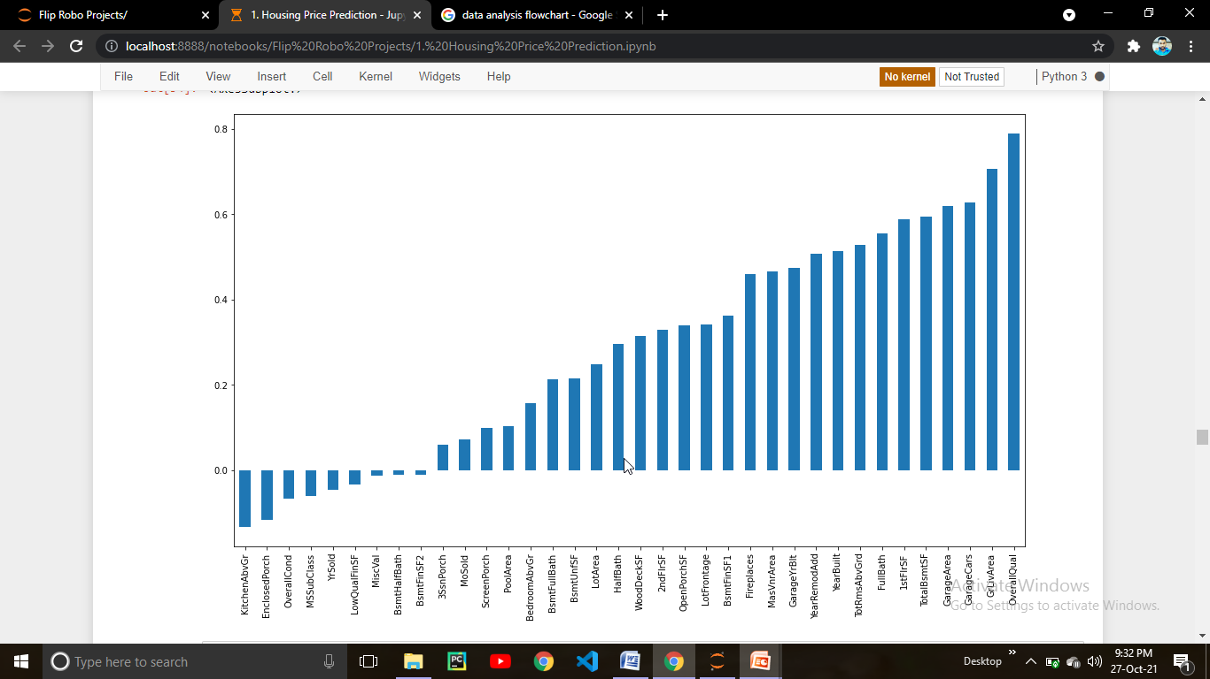
BAR GRAPH
Bar graphs are used to compare things between different groups or to track changes over time.
Here we are comparing the correlation values between the feature columns and the target label column which is Sale Price in our scenario.
It gives us an insight on positive and negative correlated column details.

Slide 15
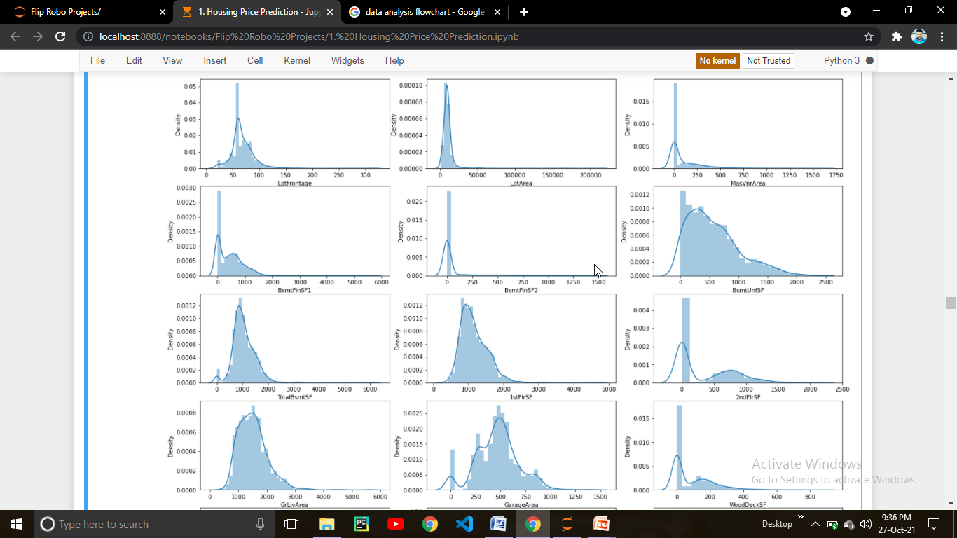
DISTRIBUTION PLOT
Distribution plots visually assess the distribution of sample data by comparing the empirical distribution of the data with the theoretical values expected from a specified distribution.
Here we have used it to analyze the skewness information for numeric datatype column values.
The acceptable form usually is a normal distribution resembling a bell shape curve.

Slide 16
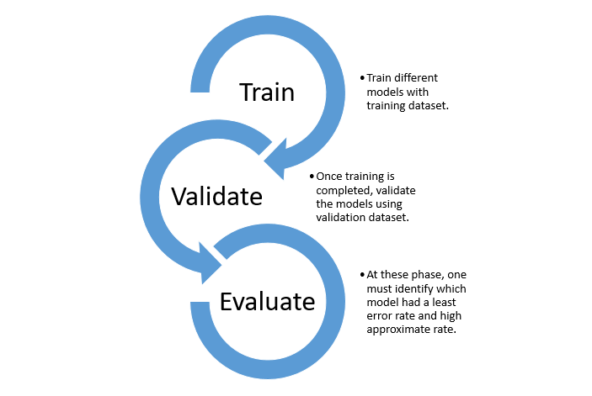
MODEL TRAINING PHASES

Slide 17
MODEL/S DEVELOPMENT
Linear Regression Model
Lasso Regularization Model
Ridge Regularization Model
ElasticNet Regularization Model
K Nearest Neighbours Regression Model
Support Vector Regression Model
Decision Tree Regression Model
Random Forest Regression Model
Extra Trees Regression Model
Ada Boost Regression Model
Gradient Boosting Regression Model
Bagging Regressor Model
XGBRegressor Model
VotingRegressor Model

Slide 18
EVALUATION AND HYPER PARAMETER TUNING
The key metrics used here were:
R2 score
Cross Validation Score
MAE
MSE
RMSE
We tried to find out the best parameters list to increase our accuracy scores by using Hyperparameter Tuning.
In order to achieve a higher score we used the Grid Search CV method with 5 folds.

Slide 19
CONCLUSION AND SCOPE FOR FUTURE WORK
During this project I have faced a problem of low amount of data for training the machine learning models upon.
Many columns are with same entries in more than 80% of rows which lead to reduction in our model performance.
One more issue present is there are large number of missing values in this data set, so we have to fill those missing values in correct manner manually.
We can still improve our model accuracy with some feature engineering and by doing some extensive hyperparameter tuning on it.

Slide 20


